Slide 1
Digital Portfolio
SSTUDENT NAME: M. Gowtham
REGISTER NO: 24134060500121018
NMID: asanm40624134060500121018
DEPARTMENT: BCA(II year)
COLLEGE: DHARMAPURAM ADHINAM ARTS
COLLEGE Mayiladuthurai
AFFILIATED: ANNAMALAI
UNIVERSITY, ANNAMALAI NAGAR CHIDAMBARAM

Slide 2
PROJECT TITLE
CREATIVE STUDENT
PORTFOLIO USING FWD

Slide 3


AGENDA
Problem Statement
Project Overview
End Users
Tools and Technologies
Portfolio design and Layout
Features and Functionality
Results and Screenshots
Conclusion
Github Link
3/21/2024 Annual Review

Slide 4

PROBLEMSTATEMENT
A digital portfolio provide an interactive and accessible platform tonperform achivements,skills and experience

Slide 5

PROJECT OVERVIEW
A digital portfolio provide an interactive and accessible platform tonperform achivements,skills and experience

Slide 6

WHO ARE THE END USERS?
*students( projects,resumes) *Job seekers(career counseling) *young professionals(leadership skills)

Slide 7

TOOLS AND TECHNIQUES
#HTML-->Structure #CSS-->Styling #JS-->Interactivity

Slide 8
POTFOLIO DESIGN AND LAYOUT
*Home/About me *Project *Skills *Contact *Responsive layout
8

Slide 9
FEATURES AND FUNCTIONALITY
*Navigation bar-with smooth scrolling *Project showcase with image/details *Contact form( Valiclation) *Respondive design for all devices

Slide 10
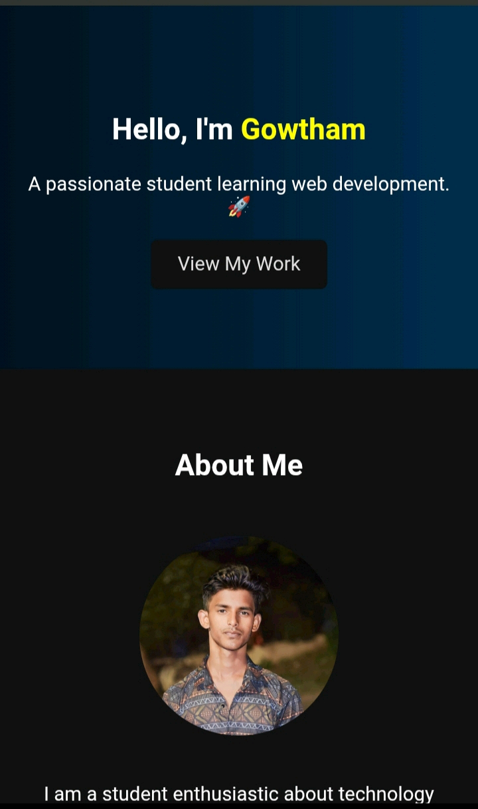

RESULTS AND SCREENSHOTS
3/21/2024 Annual Review
10

Slide 11
CONCLUSION
The project has been a resounding success,empowering students and young laeders with the,knowledge and confidence to become innovation problem-solvers and change makers
11

